Slide 1
Survey of labour and issues confronting Gatineau Valley companies
RESEARCH REPORT
Presented to the Gatineau Valley and its partners
February 2023

Slide 2
Table of Contents
Highlights | 3
Objectives and methodology | 9
1. Respondent profiles 2. Job profiles | 15 18
3. Job forecasts | 30
4. Recruiting | 34
5. Training | 37
6. issues and challenges | 41
7. Cybersecurity | 49
8. Sustainable development and environmental management | 55
9. Company management succession | 63
Appendix – Questionnaire | 67

Slide 3
Highlights

Slide 4
Highlights (1/5)
Objectives and methodology
The Gatineau Valley SADC and its partners, Services Québec and the Gatineau Valley SADC, retained BIP Recherche to conduct a survey of companies on its territory to gain a picture of the labour situation (job profiles, forecasts over the next three years, recruiting, training) and identify the issues confronting companies.
Data was collected using a combined telephone-online method from November 28, 2022 to January 19, 2023. There were 233 respondents, the margin of error was 5.1% and the response rate was 42.3%.
Respondent profiles
The breakdown of respondents per sector was as follows: 21% in the primary sector, 79% in the tertiary sector (including 24% in retailing, 12% in accommodation, restaurants and tourism, 14% in the public and para-public sectors and 29% in the other services).
34% of companies have less than 5 employees, and 13% have 20 and over. More than two-thirds of respondents either own or co-own their company.
Job profiles
The 233 companies surveyed have a total of 3.254 employees, which averages out to 14 per company, but the median is far lower (7). They break down as follows: 8.3% full time (59%), 2.9% part time (21%) and 2.8 seasonal (20%). However, 42% have no part-time employees and 53% have no seasonal employees. The public and para-public sectors have a much higher average number of employees (28.3%).
Respondents employ slightly more men (54%) than women (46%), but the differences are much larger depending on the sector (men account for 81% of employees in the primary and secondary sectors and women 58% in the public and para-public sectors).

Slide 5
Highlights (2/5)
Job profiles (cont’d)
The workforce is relatively older : 30% of employees are less than 35 (12% less than 25) and 30% are 55 and over. Employees in the primary and retail sectors are younger on average, while workers in the secondary sector are older.
Close to half of employees (45%) have less than 5 years’ seniority and 22% have 15 years and over.
52.8% of jobs are low-skilled or unskilled, i.e., they do not require a diploma or just a general high school diploma, whereas 12% are highly qualified jobs requiring university training. More low-skilled or unskilled jobs are in the primary sector, accommodation, restaurant and tourism sector and in retailing. There is a greater proportion of highly skilled jobs in the public and para-public sectors.
Job forecasts
75%, 68% and 67% of respondents able to respond will have at least one job vacancy in 2023, 2024 and 2025 respectively.
The forecasted average number of job vacancies per company will be 3.7 in 2023, 2.7 in 2024 and 3 in 2025. A projection including respondents unable to respond (in other words all 233 respondents) shows that there will be 861, 636 and 695 job vacancies for each of the three years for a grand total of 2,192.
From a qualification standpoint, the vacancies break down as follows: 11% highly qualified, 35% skilled or semi-skilled and 54% low-skilled or unskilled.

Slide 6
Highlights (3/5)
Recruiting
In a context of labour shortages, the main actions that respondents have taken or would be willing to take include hiring people from Indigenous communities (72%), retirees (71%), immigrants or members of cultural communities (67%) and those less qualified than the employers would like (57%).
Conversely, the least mentioned groups were workers with a criminal record (30%) or with mental health issues (25%).
Training
According to the companies surveyed, the training approach most preferred is on-the-job learning (80%). Other approaches (recognition of acquired competencies, in-class training, online training, work-study were found suitable by about half of the respondents.
There is a wide range of training requirements, but the top five most often cited are in:
Occupational health and safety (56%);
Office automation, secretarial services and accounting (43%);
Management: administration, human resources management, communication, marketing, etc. (42%);
Technology and computers (32%);
Technical training in industrial trades (agri-food, manufacturing, construction sectors, storage, transport, etc.). (28%).

Slide 7
Highlights (4/5)
Issues and challenges
In the next few years, the most important issues or challenges confronting the companies surveyed are:
employee recruiting (86 %) and retention (84%);
Improving the image and attractiveness of the company and employee competency development (82% each);
Reducing the environmental footprint (71%);
Cybersecurity (64%);
Supplier requirements and the implementation of digital technologies (57% each);
Innovation (products, processes, services, marketing) (55%) and changing behaviours of workers (55% each).
To meet these challenges, respondents mentioned several types of needs for assistance or consulting support, mainly an employee training or development plan (54%), assistance with promoting the company’s image (employer marketing) (46%), information on the latest human resources management trends (43%), exchanges or networking with other companies to find out the action they have taken (42%) and assistance with innovation (40%).
Cybersecurity
31% of respondents are aware of Quebec’s Law 25 to come into force in September 2023 to modernize legislative provisions as regards the protection of personal information
53% believe that the risk of their falling victim to computer security incidents is very important or rather important (intrusions, hacking, ransom, etc.). However, only 9% were the target of computer security incidents in the past three years.
Half of the companies implemented measures to strengthen the security of their information and management systems in the past three years. Two-thirds of them are planning on further strengthening these measures in the coming year.

Slide 8
Highlights (5/5)
Sustainable development and environmental management
Overall, the respondents had a good understanding of the sustainable development concept. Three-quarters believe that the economic, social or environmental dimensions are included in this concept, while two-thirds believe that the three are included.
Slightly less than two-thirds of the companies (64%) have made commitments to reduce their environmental footprint, but these commitments only have quantifiable targets in 6% of the cases. Of those that have not made any commitments, one-third intend to do so in the next two years.
Customers of only 27% of the respondents have demanded that the latter make a commitment to reduce their environmental footprint.
To reduce their environmental footprint, the aspects deemed most important by respondents are waste management (average of 8.2/10), energy efficiency (7.6/10) and water management (7.5/10).
Company management succession
Slightly more than one-third of respondents (35%) plan on giving up their ownership of the company in the next five years.
Of those planning to leave, the planning process is not too far along: 49% have begun thinking about it and 25% have lined up a successor.

Slide 9
Objectives and methodology

Slide 10
Objectives and methodology(1/5)
OBJECTIVES
The Gatineau Valley SADC– and its partners Services Québec and the Gatineau Valley RCM – retained BIP Research to survey companies on its territory. The purpose of this survey is to document an action plan on the area’s requirements with respect to the current labour situation confronting companies and their upcoming needs over the next one to three years. It will also define companies’ needs to better orient strategic actions to support entrepreneurs as they adjust their business model. This survey is further to the one conducted four years ago in late 2018 which focused exclusively on human resources, but this time, the survey examines other themes in addition to the labour situation. The following is a list of the specific objectives.: Prepare a profile of the jobs in companies operating on the territory: number of employees according to status, breakdown of jobs according to gender, age, seniority and level of qualification, etc. Make job forecasts over the next three years (2023 to 2025). Identify recruiting actions taken by companies to deal with the labour shortage. Determine training requirements. Identify the main issues and challenges confronting companies. Delve more deeply into the cybersecurity problem. Examine in greater detail the problems of sustainable development and environmental management. Gain an idea of what business owners have been doing in terms of succession (owner profile, projected departure, stage they ae at in their succession planning).

Slide 11
Objectives and methodology(2/5)
TARGETED COMPANIES AND SAMPLE
Companies located on the territory of the Gatineau Valley RCM. They have at least one salaried employee, whether full time, part time or seasonal. We sought to have either the owner or the general manager respond to the survey. If neither was available, we went with another manager such as the human resources or the production/operations manager. We wish to point out that the data from companies with establishments or outlets outside the Gatineau Valley RCM is excluded from this survey. The sample was developed using two sources – the data base used during the 2018 survey and a list purchased from Data Axle Canada (previously Info Canada). The total sample includes 1.408 names of companies that are theoretically established in the Gatineau Valley RCM, once duplications between both data bases and within each base have been eliminated. QUESTIONNAIRE The questionnaire includes 80 variables and was designed jointly by SADC and its partners along with BIP Recherche. If the person responding to the survey was not the owner of the business, the section on business succession (six variables) did not apply. The questionnaire appears in the index.

Slide 12
Objectives and methodology(3/5)
DATA COLLECTION METHOD
Data was collected at three different times: Shortly before collection began, the partners promoted the survey with companies on the territory to encourage them to respond. BIP Recherche used a combined telephone-online method. All respondents were first contacted by telephone in either French or English. Once the introduction was read and the objectives explained, eligible respondents agreeing to participate could choose between responding by phone or online. We sent those who choose to respond online an invitation email with a link providing them access to the survey. Those opting for the online method were phoned or emailed (if we could not reach them by phone) one week after the link was sent out from those who did not complete the questionnaire and send it in. If needed, four telephone reminders were used. The questionnaire was available in French and in English as per the respondent’s preference. Completing the questionnaire took about 20 minutes. The questionnaire was piloted with about ten or so companies on November 28, 2022. No changes were made to the questionnaire following the pretest. Data collection per se ran from November 30, 2022 to January 19, 2023 with a two-week pause during the Christmas season.

Slide 13
Objectives and methodology(4/5)
Frequence
TOTAL
SAMPLE AND PARTICIPATION RATE
Data was collected from 233 respondents, 135 by phone (58%) and 98 online (42%). The data base from which data was collected was of poor quality. Of the 1.408 names, 790 (56%) were invalid, outside the sample or ineligible. The actual population consisted of 618 names. The response rate was 42.3%, a high figure for a company survey. By comparison, the corresponding figure for the 2018 survey was 35%. The maximum margin of error for a sample of that size for a finite population is ±5.1%, 19 times out of 20.
(Translation of the French below appears on the notes page)
Generated numbers
1 408
A.
Invalid numbers
396
Out of service/no telephone contact
321
Residential
69
Fax / Modem
6
B.
Numbers outside the sample/ineligible
394
Company closed
107
Outside the sector: not on the Gatineau Valley
RCM
20
No salaried employee (self-employed worker)
267
C.
Numbers in the sample where eligibility
could not be established
148
No answer/voicemail
(1)
96
Refused before eligibility could be established
52
D.
Eligible numbers in the sample where
the interview was not completed
237
Prolonged absence
4
(1)
Pour qu'un numéro puisse être considéré comme
pas de réponse
, il doit
Incomplete questionnaires (refused to complete)
6
correspondre à un numéro qui a toujours été sans réponse tout au long de la collecte
Appointment set but interview not completed
de données. Ainsi, par exemple un rendez-vous non complété pour lequel il n'y a pas
(respondent absent) or appointment set for
de réponse au moment du rappel doit être considéré comme
rendez-vous non
after the collection period ended
79
complété
et non pas comme
pas de réponse
.
Web link sent and questionnaire not completed
47
(2)
Présenté selon les normes de l'ARIM.
Refused after eligibility was established
101
(3)
TAUX D'ADMISSIBILITÉ :
D+E
470
0.54
E.
Completed interviews
233
B+D+E
864
Response rate calculation
(2)
E
233
42,3%
(3)
C x (TA
)+D+E
551
Notes:
For a number to be considered a no answer, it must be a number where no response was given throughout the data collection process. For example, an incomplete appointment for which no response was given during the callback must be considered an incomplete appointment, not a no answer.
As per ARIM standards
ELIGIBILITY STANDARDS D+E 470 0.54
B=D=E 864

Slide 14
Objectives and methodology(5/5)
SEGMENTATION VARIABLES
The findings were analyzed using several segmentation variables (see table below). They were used to perform a bivariate statistical analysis where dependent variables were crossed with independent or segmentation variables, a process intended to identify whether there were statistically significant differences per respondent sub-group.
 | The entire questionnaire, except the section on the company’s succession. | Section: within the purview of company management
Segmentation variables | NCIAS activity sector | NCIAS activity sector
 | Total number of employees (less than 5; 5 to 14; 15 and over) | Total number of employees (less than 5; 5 to 14; 15 and over)
 | Establishment according to gender: mostly women(> 60%); parity (40% to 60%); mostly men (> 60%) | Gender of business owner (man; woman)
 | Establishment according to age: overrepresented by 25 and under (25% and over); overrepresentation under 55 and over (25% and over) | Owner’s age (˂45 yrs; 45-54 yrs; 55-64 yrs; 65 and over)
 | Establishment according to qualification: mostly skilled jobs (highly and semi) (60% and over); mostly low/unskilled jobs (60% and over); pretty much the same (40% to 59%) | Business owner’s education (high school or less, college, university)
 | Business owner (yes, no) | Number of years as owner (˂5 yrs; 5-9 yrs; 10-19 yrs; 20 yrs and over)
 | Commitments to reduce environmental footprint (yes, no)
FINDINGS
Figures/symbols in colour and items in shaded bubbles indicate significantly different findings (lower in red, upper in green), from a statistical standpoint than those noted from other respondents (according to a confidence interval of 95% or over). The total may not match the sum of the parts (e.g., 99% or 101%) due to rounding or to a no answer. The total can even far exceed 100% for questions where several options were possible.

Slide 15
1. Respondent profiles

Slide 16
Activity sector
 | TOTAL Businesses | SECTORIAL GROUPS
BUSINESS ACTIVITY SECTOR | (n=233) | (n=233)
Agriculture, forestry, fishing and hunting (n=18) | 8% | Primary and secondary sectors 21%
Construction (n=20) | 9%
Manufacturing (n=10) | 4%
Retailing (n=56) | 24% | Retailing 24%
Accommodation, restaurants and tourism (n=28) | 12% | Accommodation, restaurants and tourism 12%
Wholesaling (n=2) | 2% | Tertiary sector – other services 29%
Transport and storage (n=9) | 4% | Secteur tertiaire – autres services 32 %
Arts, performances and leisure (n=5) /Information industry and culture industry (n=2) | 3%
Finances and insurance (n=2) | 1%
Real estate services and rental services (n=2) | 1%
Professional, scientific and technical services (n=14) | 6%
Administrative, support, waste management and purification services (n=8) | 3%
Other services except for public administrations (n=25) | 11%
Health care and social assistance (n=14) | 6% | Public and para-public sectors (health-social services and education) 14%
Teaching services (n=5) | 2%
Public administration (n=13) | 6%
The primary and secondary sectors account for 21% of the respondents.
79% of the respondents work in the tertiary sector, including 18% in retailing, 12% in accommodation, restaurants and tourism, 14% in the public and para-public sectors (health-social services and education) and 29% in other tertiary sector services.
Tertiary sector
79 %
Activity sector – imported variable. Base: All respondents (n=233).

Slide 17
Size
Ownership
 | TOTAL companies
NUMBER OF EMPLOYEES (full time, part time and seasonal) | (n=233)
1 to 4 | 34%
5 to 14 | 36%
15 to 24 | 17%
20 to 49 | 9%
50 and over | 4%
 | TOTAL companies
OWNER OR CO-OWNER OF THE BUSINESS | (n=233)
Yes | 63%
No | 37%
Close to two-thirds of respondents own or co-own the business.
One-third of businesses are micro businesses (fewer than 5 employees), 36% have between 5 and 14 employees and only 4% have 50 employees and over.
Q3. Including yourself, how many employees work in your business? Base: All respondents (n=233).
Q1d. Do you own the business? Base: All respondents (n=233).

Slide 18
2. Job profiles

Slide 19
Number of employees (1/2)
The 233 companies surveyed have a total of 3.254 employees. The companies, on average, have 14 employees, including 8.3 full-time (59 %), 2.9 part time (21 %) and 2.8 seasonal (20 %). More than four out of ten have no part-time employees (42%) and more than half do not have any seasonal employees (53%). These averages are pulled up by respondents with 25 employees and over. As a result, the median is a more representative indicator of the situation when determining the total number of employees. The median is 7.
In comparison with the 2018 survey, the number of full-time employees is slightly higher, and the numbers of part-time and seasonal employees are lower.
 | TOTAL | Full time | Part time | Seasonal
 | (n=233) | (n=233) | (n=233) | (n=233)
Number of employees
None | 0% | 6% | 42% | 53%
1 to 4 | 34% | 50% | 42% | 33%
5 to 14 | 36% | 27% | 12% | 11%
14 to 24 | 17% | 10% | 4% | 3%
25 to 49 | 9% | 5%
50 and over | 4% | 2%
AVERAGE NUMBER OF EMPLOYEES | 14 | 8.3 | 2.9 | 2.8
Average number of employees 2018 | 14.9 | 7..4 | 3.9 | 3.6
MEDIAN | 7.0 | 4.0 | 1.0 | 0.0
Total number of employees | 3 254 | 1 936 | 675 | 643
+
TOTAL – highest average number:
Public and para-public sectors (28.3)
Non-business owner(21.5)
Environmental commitments (16.0)
+
Full time – highest average number:
Public and para-public sectors (18.4)
Non-business owner (13.3)
+
PART TIME – highest average number:
Public and para-public sectors (7.0)
Non-business owner(4.2)
Environmental commitments (3.7)



+
SEASONAL – Highest average number:
Primary sector (4.9)
Accommodation, restaurants and tourism (8.4)
>60 % low-skilled or unskilled employees(4.1)
Non-business owner (4.0)
Environmental commitments (3.5)
Average calculations include zeros.
Q3. Including yourself, how many employees work in your company? Base: All respondents (n=233).

Slide 20
Number of employees(2/2)
Number of employees based on the main activity sectors
Number of employees | ALL SECTORS | PRIMARY AND SECONDARY SECTORS | Primary sector | Secondary sector | TOTAL TERTIARY SECTOR | Retail | Accommodation, restaurants and tourism | Public and para-public sectors | Tertiary sector – other services
 | (n=233) | (n=48) | (n=18) | (n=30) | (n=185) | (n=56) | (n=28) | (n=32) | (n=69)
Full time – average number | 8.3 | 5.6 | 3.7 | 6.8 | 9.0 | 9.6 | 6.4 | 18.4 | 5.3
Part time – average number | 2.9 | 0.9 | 1.1 | 0.8 | 3.4 | 4.5 | 2.5 | 7.0 | 1.2
Seasonal – average number | 2.8 | 3.4 | 4.9 | 2.5 | 2.6 | 1.1 | 8.4 | 3.0 | 1.3
TOTAL – average number | 14.0 | 10.0 | 9.7 | 10.2 | 15.0 | 15.1 | 17.3 | 28.3 | 7.8
TOTAL – total number | 3 254 | 480 | 175 | 305 | 2 774 | 846 | 484 | 907 | 537
Distribution of no. of employees | 100% | 14.8% | 5.4% | 9.4% | 85.2% | 26.0% | 14.9% | 27.9% | 16.5%
The average number of employees is significantly higher in companies in the public and para-public sectors (full time, part time and total) and for seasonal employees in companies in the accommodation, restaurants and tourism sector and the primary sector (which consists mainly of farming companies).
It is significantly lower in the other services in the tertiary sector (full time, part time, seasonal and total), in the primary sector (full time, part time and total), in the secondary sector (part time only) and retailing (seasonal only).
Q3. Including yourself, how many employees work in your company?
Base: All respondents (n=233).

Slide 21
Number of positions
The companies that responded have an average of 8.6 employees, an average that is pulled up by respondents with 20 positions and over. As a result, the median is a more representative indicator of the situation to determine the total number of positions. The median, in this instance, is 4.0. With respect to the data on the number of employees (page 17), it is noted that the number of employees is 1.63 times greater than the number of positions.
The average number of positions is significantly higher in companies in the public and para-public sectors and the accommodation, restaurant and tourism sector. It is lower in companies in the primary sector and in other tertiary sector services.
 | TOTAL
 | (n=233)
Number of positions
1 or 2 | 28%
3 to 5 | 32%
6 to 9 | 18%
10 to 19 | 15%
20 and over | 8%
AVERAGE NUMBER OF POSITIONS | 8.6
MEDIAN | 4.0
+
Highest average number:
Public and para-public sectors (20.0)
Accommodation, restaurants and tourism (11.7)
Non-business owner(14.3)
–
Lowest average number:
Primary sector (4.9)
Tertiary sector (5.3)
Company owner (5.1)
Don’t know answers (7%) have been excluded from the calculations.
Q4. How many jobs does your company have? Base: All respondents (n=233).

Slide 22
Distribution of employees according to gender (1/2)
On average, the respondents employ slightly more men (54%) than women (46%). The distributions in the 2018 survey were exactly the same.
However, there were significant variations in the gender-based distribution depending on the business category (see the bullets in the lower right and the graph on the following page). For example, the proportion of men in the primary and secondary sectors is quite high at 81%. Conversely, women are a majority in the tertiary sector in general (53%), particularly in the public and para-public sectors (58%), accommodation, restaurants and tourism (55%) and in retailing (55%).
 | Men | Women
 | (n=233) | (n=233)
Proportion of employees
0% to 9% | 12% | 17%
10% to 49% | 22% | 28%
50% to 89% | 47% | 40%
90 to 100% | 18% | 14%
AVERAGE DISTRIBUTION | 54.0% | 46.0%
Average distribution in 2018 | 54.3% | 45.7%
+
MEN – highest proportion:
Primary and secondary sectors (81.3%)
Company owners (59.7%)
WOMEN – highest proportion:
Tertiary sector (52.9%)
Public and para-public sectors (57.7%)
Accommodation, restaurants and tourism (55.3%)
Retailing (55.3%)
Non-business owner (55.6%)
+
Q5. Please provide a distribution of your employees based on gender in %.
Base: All respondents (n=233).

Slide 23
Distribution of employees according to gender(2/2)
Average distribution of employees based on gender in the main activity sectors
TOTAL BUSINESSES
Men
Women
Q5. Please provide a distribution of your employees based on gender in %.
Base : All respondents (n=233).

Slide 24
Distribution of employees according to age (1/2)
Data on employee ages show that the respondents’ workers are somewhat older. Seven in ten (70%) are 35 and over, and close to one-third (30%) are 55 and over. Only 12% are under 25, and 45% of companies employ no one under 25. Any variations with the 2018 survey are minimal and insignificant.
The proportion of young employees (less than 25) exceeds the average in the primary sector and lower than the average in the other tertiary sector services. The proportion of employees in the public and para-public sectors is above average in the 35-54 segment.
The proportion of older employees (55+) is higher than the average in other tertiary sector services, microbusinesses (1-4 employees) and in those where the owner was the respondent. It is below the average in the public and para-public sectors.
 | Less than 25 | 25-34 yrs | 35-54 yrs | 55 and over
 | (n=233) | (n=233) | (n=233) | (n=233)
Proportion of employees
0% | 45% | 37% | 14% | 23%
1% to 49% | 50% | 54% | 45% | 49%
50% and over | 5% | 9% | 41% | 29%
AVERAGE DISTRIBUTION | 12.4% | 17.6% | 39.8% | 30.2%
Average distribution in 2018 | 11.7% | 18.9% | 39.9% | 29.5%
LESS THAN 25– highest proportion:
Primary sector (19.7%)
25-34 YRS – highest proportion:
15 employees and over (22.6%)
+
35-54 YRS – highest proportion:
Public and para-public sectors (46.4%)
Non-business owner (44.4%)
55+ YRS – highest proportion:
Tertiary sector, other (35.9%)
1 to 4 employees (39.5%)
Business owner (33.4%)
Don’t know answers (1%) are excluded from the calculations.
Q6. Please provide a breakdown of your employees according to their age.
Base : All respondents (n=233).

Slide 25
Distribution of employees according to age(2/2)
Average distribution of employees according to the main activity sectors
TOTAL COMPANIES
Under 25
25-34 yrs
35 to 54 yrs
55 and over
Q6. Please provide a breakdown of your employees according to their age.
.
Base : All respondents (n=233).

Slide 26
Distribution of employees according to seniority (1/2)
Data on employee seniority shows that close to half (45%) have less than 5 years’ seniority and 20% between 5 and 9 years. Slightly more than one in five employees has at least 15 years’ seniority. Since the 2018 survey, seniority has decreased significantly: those with less than 5 years are up by 5.9 percentage points and those with 15 years and over are down 4.5%. This could reflect greater labour mobility in a context of full employment and shortages.
The proportion of employees with less than 5 years’ experience is higher than the average in retailing and in companies with 5 to 14 employees. The public and para-public sectors and companies with 15 employees and over account for a more significant proportion of employees with between 10 and 14 years of seniority.
The proportion of employees with at least 15 years’ seniority is highest in the primary sector and in other services in the tertiary sector, in microcompanies (1 to 4 employees) and among those where the owner was the respondent.
 | Less than 5 years | 5-9 yrs | 10-14 yrs | 15 yrs and over
 | (n=233) | (n=233) | (n=233) | (n=233)
Proportion of employees
0% | 13% | 37% | 49% | 41%
1% to 49% | 38% | 46% | 43% | 39%
50% and over | 49% | 17% | 8% | 20%
AVERAGE DISTRIBUTION | 45.5% | 19.8% | 13.2% | 21.5%
Average distribution 2018 | 39.6% | 21.2% | 13.2% | 26.0%
LESS THAN 5 YEARS – highest proportion:
Retailing (50.8%)
5-14 employees (51.8%)
+
5-9 YRS – highest proportion: None
10-14 YRS – highest proportion:
Public and para-public sectors (19.5%)
15 employees and over (16.8%)


15+ YRS – highest proportion:
Primary sector (28.1%)
Tertiary sector, others(26.1%)
1 to 4 employees (25.7%)
Business owner (24.5%)
Don't know answers (2%) are excluded from the calculations.
Q7. Please provide a percentage breakdown of employees according to seniority.
Base : All respondents (n=233).

Slide 27
Distribution of employees according to seniority (2/2)
Average distribution of employees according to the main activity sectors
TOTAL COMPANIES
Less than 5 yrs
5-9 yrs
10 to 14 yrs
15 yrs and over
Q7. Please provide a breakdown of your employees according to seniority.
Base: All respondents (n=233).

Slide 28
Breakdown of employees according to job qualification level (1/2)
More than half (52.8%) of employees in the companies surveyed hold low-skilled or unskilled jobs, which require no diploma or only a general high school diploma. Slightly more than one-third (35.2%) occupy skilled or semi-skilled jobs, requiring a technical college diploma (DEC) or a DVS. Highly qualified jobs requiring university training only represent 12% of the total. In fact, 56% of companies surveyed have no highly qualified jobs, and 59% have at least half of their jobs that are filled by low-skilled or unskilled labour. In comparison with the 2018 survey, the proportion of low-skilled or unskilled jobs has edged up (+2.8 points) at the expense of highly qualified and qualified or semi-qualified jobs.
 | Very skilled jobs | Skilled or semi-skilled jobs | Low-skilled or unskilled jobs
 | (n=233) | (n=233) | (n=233)
Proportion of employees
0% | 56% | 30% | 22%
1% to 49% | 32% | 34% | 19%
50% and over | 11% | 36% | 59%
AVERAGE DISTRIBUTION | 12.0% | 35.2% | 52.8%
Average distribution 2018 | 13.0% | 37.0% | 50.0%
+
HIGHLY QUALIFIED– highest proportion:
Public and para-public sectors (22.9%)
Tertiary sector, other (17.9%)
>60 % female employees (20.3%)
Non-business owner ( 17.6%)
+
SKILLED-SEMI-SKILLED – highest proportion:
Secondary sector (43.8%)
Public and para-public sectors (46.1%)
Tertiary sector, other (44.1%)
Don't know answers (1%) are excluded from the calculations.
LOW-SKILLED/UNSKILLED – highest proportion:
Primary sector (64.7%)
Accommodation, restaurants and tourism (71.6%)
Retailing (70.9%)
As many men as women (63.6%)
Business owner (58.0%)
+
Highly qualified jobs: generally require university training: managers, management level employees and professionals.
Skilled or semi-skilled jobs: require technical training at the college level (technical DEC) or high school-level vocational (DVS).
Low-skilled or unskilled jobs: require a general high school diploma or no diploma.
Q8. Please provide a percentage breakdown of your job qualification levels.
Base : All respondents (n=233).

Slide 29
Breakdown of employees according to job qualification level (2/2)
Average distribution of employees by qualification level according to the main activity sectors
TOTAL COMPANIES
The proportion of highly qualified jobs exceeds the average in the public and para-public sectors and the other tertiary sector services
At the other end, there are few low-skilled or unskilled jobs in the primary sector, accommodation, restaurant and tourism and retailing sectors.
Skilled or semi-skilled jobs are proportionately more present in the secondary, public and para-public and other tertiary sector services sectors.
Highly skilled
Skilled or semi-skilled
Low-sklled or unskilled
Q8. Please provide a percentage breakdown of your job qualification levels.
Base : All respondents (n=233).

Slide 30
3. Job forecasts

Slide 31
Number of jobs to fill (1/2)
Over the next three years, a rather strong majority of respondents – 75% in 2023, 68% in 2024 and 67% in 2025 – will have at least one job vacancy to fill due to job creation or to replacements for retiring employees. Note that the percentage of respondents who could not answer (DNK) has increased over the years: 12% for 2023, 28% for 2024 and 37% for 2025.
Companies able to answer will have, on average, 3.7 (in 2023), 2.7 (in 2024) and 3.0 (in 2025) vacancies to fill. In absolute numbers, there will be 754, 456 and 439 jobs over the next three years respectively, a grand total of 1,649.
If we project these figures to include respondents that could not answer (all 233 survey respondents), vacancies climb to 861, 636 and 695 for each of the next three years, a grand total of 2,192. When the number of jobs to fill is expressed as a ratio of the total number of employees in 2022 (3,254), the figures are 26% in 2023, 20% in 2024 and 21% in 2025. This shows how important filling these vacancies really is.
 | 2023 | 2024 | 2025
n excluding DNK | (n=204) | (n=167) | (n=147)
Number of jobs to fill
None | 25% | 32% | 33%
1 or 2 | 39% | 32% | 31%
3 to 5 | 22% | 25% | 21%
More than 5 | 14% | 11% | 14%
Average number of jobs to fill | 3.7 | 2.7 | 3.0
MEDIAN | 2.0 | 2.0 | 2.0
Total number (excluding DNK) | 754 | 456 | 439
Projection including all respondents (233) | 861 | 636 | 695
Ratio projection/no of employees in 2022 | 26% | 20% | 21%
Don’t know | 12% | 28% | 37%
+
2023 – Highest average number:
Accommodation, restaurants and tourism (9.9)
60 %+ semi-skilled or unskilled employees (5.2)
Non-business owner (5.0)
Environmental commitments (4.6)
+
2024 – Highest average number:
Primary sector (4.0)
Accommodation, restaurants and tourism 5.4)
60 %+ low-skilled or unskilled employees (3.3)
Environmental commitments (3.3)
TOTAL FOR THE 3 YEARS
1,649
2,192
+
2025 – Highest average number:
Accommodation, restaurants and tourism (5.2)
Public and para-public sectors (4.1)
Environmental commitments (3.6)
Calculations of averages include zeros (no vacancies)
Q9. How many jobs do you think you will have to fill in each of the next three years? This includes new jobs created, including part-time and seasonal, along with replacements for employees who retire. Base: All respondents (n=233).

Slide 32
Number of jobs to fill (2/2)
Number of jobs to fill | ALL SECTORS | PRIMARY AND SECONDARY SECTORS | Primary sector | Secondary sector | TOTAL TERTIARY SECTOR | Retailing | Accommodation, restaurants and tourism | Public and para-public sectors | Tertiary sector, other services
n excluding DNK: 2023/2024/2025 | 204/167/147 | 42/36/34 | 17/14/14 | 25/22/20 | 162/131/113 | 44/31/28 | 27/24/22 | 28/21/17 | 63/55/46
2023 Average number per respondent | 3.7 | 2.8 | 3.5 | 2.3 | 3.9 | 3.4 | 9.9 | 4.5 | 1.4
Total number (excluding DNK) | 754 | 118 | 60 | 58 | 636 | 151 | 268 | 127 | 90
Projection, all respondents | 861 | 135 | 64 | 71 | 726 | 196 | 282 | 148 | 100
2024 Average number per respondent | 2.7 | 2.8 | 4.0 | 2.0 | 2.7 | 3.1 | 5.4 | 2.3 | 1.5
Total number (excluding DNK) | 456 | 99 | 56 | 43 | 357 | 95 | 130 | 48 | 84
Projection, all respondents | 636 | 132 | 73 | 59 | 504 | 172 | 152 | 74 | 106
2025 Average number per respondent | 3.0 | 3.1 | 3.9 | 2.6 | 2.9 | 3.3 | 5.2 | 4.1 | 1.2
Total number (excluding DNK) | 439 | 107 | 55 | 52 | 332 | 92 | 114 | 69 | 57
Projection, all respondents | 696 | 151 | 72 | 79 | 544 | 184 | 145 | 130 | 85
3 yrs Total number (excluding DNK) | 1 649 | 324 | 171 | 153 | 1 325 | 338 | 512 | 244 | 231
Projection, all respondents | 2 192 | 418 | 209 | 209 | 1 774 | 552 | 579 | 352 | 291
The jobs to be filled in the next three years – 1,649 for respondents able to answer and 2,192 with projections including the DNKs – have been broken down by major activity sector in the above table. The primary and secondary sectors represent 20% of these jobs and the tertiary sector 80%, further subdivided as follows: 25% for retailing, 26% for the accommodation, restaurant and tourism sector, 16% for the public and para-public sectors and 13% for other sectors.
Considering the average number of jobs to be filled by business, this number is significantly higher in the accommodation, restaurant and tourism sector (for the three years), in the primary sector (for 2024 only) and in the public and para-public sectors (for 2025 only). It is significantly lower in the other tertiary sector services (for the three years) and in the secondary sector (for 2023 only).
The significant variances shown on the preceding page show that the average number of jobs to be filled is significantly higher in companies with a majority of low-skilled or unskilled employees (for 2023-2024) and those that made commitments to reduce their environmental footprint (for the three years).
Q9. How many jobs do you think you will have to fill in each of the next three years? This includes new jobs created, including part-time and seasonal, along with replacements for employees who retireBase: All respondents (n=233).

Slide 33
Number of jobs to be filled based on job qualification level
Of the companies that have vacancies to be filled in 2023, 2024 or 2025, the proportion of highly qualified jobs will vary between 10% and 11%, depending on the years, skilled or semi-skilled jobs will vary between 34% and 35% and low-skilled or unskilled jobs between 54% and 55%. There is therefore no difference from one year to the next. As for the job qualification level in 2022, little difference was noted, save for a slight rise in the number of low-skilled or unskilled jobs.
The proportion of highly skilled jobs exceeds the average in the public and para-public sectors, in the other services in the tertiary sector, companies with 15 or more employees and also those with a majority of women where the person responding to the survey was not the owner. On the other end, there were more low-skilled or unskilled jobs in the primary sector, in accommodation, restaurants and tourism, retailing and in companies employing equal numbers of men and women.
 | Current jobs 2022 | Vacancies to fill (respondents that have some)
 |  | 2023 | 2024 | 2025
 | (n=233) | (n=153) | (n=114) | (n=147)
Distribution of vacancies to fill based on qualification level
Highly skilled jobs | 12.0% | 10.7% | 11.4% | 10.4%
Skilled or semi-skilled jobs | 35.2% | 35.0% | 34.3% | 34.9%
Low-skilled or unskilled jobs | 52.8% | 54.3% | 54.2% | 54.7%
HIGHLY QUALIFIED – highest proportion:
Public and para-public sectors (2023, 2024, 2025)
Tertiary sector, other (2023, 2024, 2025)
15 employees and over (2023, 2025)
>60 % female employees (2023, 2024, 2025)
Non-business owner (2023, 2024, 2025)
+
+
SKILLED/SEMI-SKILLED – highest proportion:
Secondary sector (2023, 2024, 2025)
Public and para-public sectors (2023, 2024, 2025)
Tertiary sector, other (2023, 2024, 2025)
>60 % male employees (2023, 2024)
Highly qualified jobs: generally require university training: managers, management level employees and professionals.
Skilled or semi-skilled jobs: require technical training at the college level (technical DEC) or high school-level vocational (DVS).
Low-skilled or unskilled jobs: require a general high school diploma or no diploma.
+
LOW-SKILLED/SKILLED – higher proportion:
Primary sector (2024, 2025)
Accommodation, restaurants and tourism (2023, 2024, 2025)
Retail (2023, 2024, 2025)
Equal numbers of men and women (2023, 2024, 2025)
Q10. Please distribute the number of jobs to be filled over the next three years according to the job classification level. Base: Respondents answering Q9 and having vacancies to be filled (n variable depending on the years).

Slide 34
4. Recruiting

Slide 35
Recruiting in a context of labour shortages (1/2)
(80%)

In a context of labour shortages, a rather sizeable number of respondents have either turned to or would be willing to turn to workers from Indigenous communities (72%), retirees (71%) and immigrants or members of cultural communities (67%). Fewer respondents have hired or would be willing to hire workers less skilled than desired (57%)
(39%)

(72%)

(43%)

Other strategies were mentioned quite often (more than 40%): hiring of handicapped workers (48%), sponsorship of students pursuing a specialized education (45%), mentoring of young dropouts for unskilled trades (42%) and young people far from the job market and overseen by an employability stakeholder (42%).
The least often cited strategies are as follows: workers with a criminal record (30) and those with a mental health problem (25%).
In comparison with the 2018 survey, there was a spike in the hires of retirees (+32%) and workers less skilled than desired (+14%). There was a drop in the numbers of workers from Indigenous communities (-8 points) and immigrants or members of cultural communities (-5 points).
(47%)
(The figures in brackets were taken from the 2018 survey.)
Q11. Over the next three years, and given the changes brought on by labour shortages, do you plan on resorting to the following actions?
Base : All respondents (n=233).

Slide 36
Recruiting in a context of labour shortages (2/2)
An analysis of the significant variances for each of the ten strategies that respondents either turned to or intend to turn to in order to deal with the labour shortage shows that certain segments are proportionately more inclined to go with several strategies:
Companies with 15 employees and over (positive variances for 9 of 10 strategies, except for workers with a criminal record).
The accommodation, restaurant and tourism sector (9 out of 10, with the exception of handicapped workers). This may be explained by the fact that this sector was very severely affected by the pandemic and that several workers have left this field. As a result, it is more affected by the labour shortage and thus more open to various recruiting strategies.
The public and para-public sectors (3 out of 10: the retiree, less qualified and mental health problem categories).
Companies with a large proportion of workers under 25 (4 out of 10).
+
+
Recruiting actions | Statistically significant variables
Hiring of workers from Indigenous communities | Accommodation, restaurants and tourism (89%) 15 employees and over (83%) 25%+ employees under 25 (84%) Environmental commitments (79%)
Hiring of retirees | Accommodation, restaurants and tourism (86%) Public and para-public sectors (81%) 15 employees and over (86%)
Hiring of immigrants and members of cultural communities | Accommodation, restaurants and tourism (86%) 15 employees and over (81%)
Hiring of workers less qualified than desired | Accommodation, restaurants and tourism (82%) Public and para-public sectors (66%) 15 employees and over (74%) 25%+ employees under 25 (67%) Environmental commitments (63%)
Hiring of handicapped workers | 15 employees and over (60%) 25%+ employees under 25 (55%)
Recruiting actions | Statistically significant variables
Sponsoring of students pursuing a specialized education | Accommodation, restaurants and tourism (64%) 15 employees and over (57%)
Mentoring of young dropouts for unskilled trades | Accommodation, restaurants and tourism (64%) 15 employees and over (54%) As many men as women (55%) 25%+ employees under 25 (55%) 60 %+ low-skilled or unskilled employees (54%)
Hiring of young persons some distance away from the job market | Accommodation, restaurants and tourism (61%) 15 employees and over (53%)
Hiring of workers with a criminal record | Secondary sector (47%) Accommodation, restaurants and tourism (50%)
Hiring of workers with a mental health problem | Accommodation, restaurants and tourism (43%) Public and para-public sectors (38%) 15 employees and over (39%) >60 % female employees (37%) 25%+ employees under 25 (35%)
Q11. Over the next three years, and given the changes brought on by labour shortages, do you plan on resorting to the following actions?
Base : All respondents (n=233).

Slide 37
5. Training

Slide 38
Preferred training approaches
According to the respondents, the five training approaches submitted to them reportedly meet or relatively meet their needs and their employees’ needs. On-the-job learning is by far the most suitable approach, having been mentioned by 80% (without any variance par respondent segment).
The other four approaches were cited either close to or slightly more than by half of the respondents. The recognition of acquired competencies (53%) was mentioned more often by the secondary sector. In-class learning (53%), online training (50%) and a work-study program (48%) were proportionately mentioned more often by the public and para-public sectors and by companies with 15 employees and over.
On-the-job training – most often mentioned: No variance
RECOGNITION OF ACQUIRED COMPETENCIES: most mentioned
Secondary sector (73%)
IN-CLASS TRAINING – most mentioned:
Public and para-public sector s(75%)
15 employees and over (64%)
60 %+ highly skilled or semi-skilled employees (64%)
+
ONLINE TRAINING – most mentioned:
Public and para-public sector s(78%)
15 employees and over (63%)
As many highly skilled as low-skilled/unskilled (66%)
WORK-STUDY PROGRAM – most mentioned:
Public and para-public sectors (66%)
15 employees and over (64%)
Q12. Which training approaches are best suited to your company? (Several possible options)
Base : All respondents (n=233).

Slide 39
Training requirements (1/2)
Q13. Which fields would it be beneficial for your employees to receive training in? (Several possible options)
Base : All respondents (n=233).

Slide 40
Training requirements (2/2)
The companies surveyed have multiple training requirements. However, three main training areas cited most often were occupational health and safety (56%), office automation, secretarial services, accounting (43%) and management (administration, communication, marketing, human resources management, etc.) (42%).
Another three training areas were cited between a quarter and a third of respondents – technology and computers (32%), technical training relating to industrial trades (e.g., agri-food, manufacturing, construction, storage, transportation sectors) (28%) and basic general training in-house (numeracy, literacy, problem solving, etc.). Only 8% said they did not have any training requirements.
Statistically significant variances
The requirements for certain training areas relate directly to the activity sector: industrial trades (primary and secondary), health and education (public and para-public sectors), tourism, hotels and restaurants, commerce and services. Some training, though cross-training in and of itself, affects some sectors even more: occupational health and safety (secondary sector), computer technologies, management and office automation, secretarial services and accounting (public and para-public sectors), basic general training (retailing).
+
+
Training requirements | Statistically significant variances
Occupational health and safety | Secondary sector (73%) 15 employees and over (67%) Environmental commitments (62%)
Office automation, secretarial services, accounting | Public and para-public sectors (59%) 15 employees and over (53%)
Management | Public and para-public sectors (66%) 15 employees and over (63%)
Technology and computers | Public and para-public sectors (44%)
Industrial trades | Primary sector (61%) Secondary sector (67%) >60 % male employees (50%)
Basic general training in-house | Retailing (43%)
Training requirements | Statistically significant variances
Language training | Accommodation, restaurants and tourism (36%)
Tourism, hotels and restaurants | Accommodation, restaurants and tourism (82%) As many male employees as female (35%) 60 %+ low-skilled or unskilled employees (24%)
Environment and sustainable development | Accommodation, restaurants and tourism (36%)
Health and education | Public and para-public sectors (50%) 15 employees and over (29%) >60 % female employees (37%) 60 %+ highly or semi-skilled employees (24%)
Commerce and services | Retailing (11%)
No training needed | 60 %+ low-skilled or unskilled employees (13%) No environmental commitments (15%)
Q13. Which fields would it be beneficial for your employees to receive training in? (Several possible options)
Base : All respondents (n=233).

Slide 41
6. Issues and challenges

Slide 42
Issues and challenges in the next three years (1/4)
NSP (exclus des calculs)
Total important
86%
84%
82%
82%
71%
64%
57%
57%
55%
55%
54%
54%
48%
46%
43%
42%
35%
29%
5%
6%
5%
5%
9%
7%
6%
7%
6%
11%
8%
8%
7%
9%
15%
7%
9%
11%
Q14. In the next three years, which of the following issues and challenges will be very, somewhat, not too important or not important at all for your business? Base: All respondents (n = 233).

Slide 43
Issues and challenges in the next three years (2/4)
Eighteen issues and challenges were submitted to respondents, who were asked to assess their importance over the next three years.
Four issues and challenges were deemed important (very important and rather important combined) and received a rating of more than 80%: recruiting of labour (86%), employee retention (84%), improvement of the image and attractiveness of the business (82%) and employee competency development (82%).
Two more issues were rated important by two-thirds (give or take): reduction of the environmental footprint (71%) and cybersecurity (64%).
Six issues received a similar importance rating around 55%: supplier requirements (57%), implementation of digital technologies (57%), product innovation, processes, services or marketing (55%), changing worker behaviours (55%), changing buyer or consumer behaviours (54%) and reduction or reorganization of hours of operation or opening time due to a lack of available staff (54%).
Four issues were deemed important by a strong minority of respondents (more than 40%): manager succession (48%), competition from businesses (46%), owner succession (43%) and increase in online commerce or purchasing (42%).
Only two issues are important to a third or fewer respondents: raw material supplies, components or finished products (35%) and development of markets outside the region (29%).
Q14. In the next three years, which of the following issues and challenges will be very, somewhat, not too important or not important at all for your business? Base: All respondents (n = 233).

Slide 44
Issues and challenges in the next three years (3/4)
+
+
Issues and challenges | Total of very and rather important Statistically significant variances
Recruiting | 15 employees and over (97%)
employee retention | Public and para-public sectors (97%) 15 employees and over (93%) Environmental commitments (88%)
Improvement of the image or attractiveness of the business | Environmental commitments (86%)
Employee competency development | Public and para-public sectors (100%) 15 employees and over (93%) Environmental commitments (88%)
Environmental footprint reduction | Environmental commitments (83%)
Cybersecurity | Environmental commitments (69%)
Supplier requirements | Primary sector (67%) Secondary sector (77%) Retailing (70%) >60 % male employees (67%) 60 %+ low-skilled or unskilled employees(66%)
Implementation of digital technologies in some management processes | Retailing (67%)
Innovation of products, processes, services or marketing | Primary sector (72%) Secondary sector (73%)
Issues and challenges | Total of very and rather important Statistically significant variances
Changing employee behaviours | Primary sector (67%) Public and para-public sectors (65%) 15 employees and over (65%)
Changing buyer or consumer behaviour | Accommodation, restaurants and tourism (75%) Retailing (76%)
Reduction or reorganization of hours of operation or business hours due to staff shortages | Accommodation, restaurants and tourism (63%)
Management succession | 15 employees and over (68%) Non-business owner(58%)
Competition from businesses | Retailing (68%) 60 %+ low-skilled or unskilled employees(54%)
Owner succession | Primary sector (67%) Business owner (52%)
Increase of online commerce or purchasing | Retailing (67%) 60 %+ low-skilled or unskilled employees(49%)
Supplies of raw materials, components or finished products | Secondary sector (76%)
Development of markets outside the region | Primary sector (41%) Accommodation, restaurants and tourism (44%)
Q14. In the next three years, which of the following issues and challenges will be very, somewhat, not too important or not important at all for your business? Base: All respondents (n = 233).

Slide 45
Issues and challenges in the next three years (4/4)
Statistically significant variances (table on the preceding page)
An analysis of significant variances highlights some segments of respondents are proportionately more inclined to consider some issues and challenges as important:
Larger companies, i.e., 15 employees and over (positive variance on 5 issues): recruiting, employee retention, employee competency development, changing employee behaviour, management succession
Retailing (5 issues): supplier requirements, digital technology implementation, changing buyer or consumer behaviour, competition from businesses and increase in online commerce or purchasing.
Primary sector (5 issues): supplier requirements, innovation, changing buyer or consumer behaviour, owner succession, development of markets outside the region
Secondary sector (3 issues): supplier requirements, innovation, supply of raw materials, components or finished products.
The accommodation, restaurants and tourism (3 issues): changing buyer or consumer behaviour, reduction or reorganization of hours of operation or opening times, development of markets outside the region.
Public and para-public sectors (3 issues): employee retention, employee competency development, changing buyer or consumer behaviour.
Companies that made commitments to reduce their environmental footprint (5 issues): employee retention, improvement of the image/attractiveness of the company, employee competency development, reduction of the environmental footprint, cybersecurity.
Q14. In the next three years, which of the following issues and challenges will be very, somewhat, not too important or not important at all for your business? Base: All respondents (n = 233).

Slide 46
Needs or help to deal with the issues (1/3)
Q15. What major types of needs, assistance or consulting support would be necessary to help your business deal with these issues? (Several possible options)
Base : All respondents (n=233).

Slide 47
Needs or help to deal with the issues (2/3)
The respondents cited several types of assistance or consulting support needs to deal with the issues mentioned previously. The main ones appear hereunder.
The most important was an employee training or development plan mentioned by 54%.
Four respondents in ten mentioned another four: help with promoting the image of the business (employer marketing) (46%), information on new human resources management trends (43%), exchanges or networking with other companies to find out what actions they have taken (42%) and help with innovation (40%).
One-third or close to a third referred to five needs: information on market trends (customer behaviour, competition, demographics, lifestyles, etc.) (37%), a manager/managerial level training or development plan (35%), sharing of labour with other companies (part-time or seasonal positions) (35%), and help with digital technology implementation (35%) and with the implementation of a human resources management policy (30%).
Statistically significant variances (table on the following page)
An analysis of the significant variances does shed light on certain segments of respondents, particularly some activity sectors that are proportionately more inclined to express certain needs or forms of assistance:
The accommodation, restaurant and tourism sector (positive variance for 7 needs/aid): help promoting the image of the business, exchanges/networking with other companies to find out what action they have taken, help with innovation, information on market trends, manager/managerial level training or development plan, sharing of labour with other companies, help with the implementation of a human resources management policy.
The public and para-public sectors (3 needs/aid): employee training or development plan, information on new human resources management trends, managerial level training or development plan.
Retailing (2 needs/aid): information on market trends, help with implementing online commerce.
The primary sector (2 needs/aid): help with innovation, help with developing markets outside the region.
Companies with 15 employees and over (3 needs/aid): employee training or development plan, information on new human resources management trends, help with the implementation of a human resources management policy.
Q15. What major types of needs, assistance or consulting support would be necessary to help your business deal with these issues? (Several possible options)
Base : All respondents (n=233).

Slide 48
Needs or help to deal with the issues (3/3)
+
+
Needs, assistance or consulting support | Statistically significant variances
Employee training or development plan | Public and para-public sectors (66%) 15 employees and over (67%)
Help promoting the image of the business (employer marketing) | Accommodation, restaurants and tourism (64%)
Information on new human resources management trends | Public and para-public sectors (69%) 15 employees and over (66%) Environmental commitments (49%)
Exchanges/networking with other businesses to find out what action they have taken | Accommodation, restaurants and tourism (54%) Environmental commitments (49%)
Help with innovation | Primary sector (50%) Secondary sector (52%) Accommodation, restaurants and tourism (50%)
Information on market trends (customer behaviour, competition, demographics, lifestyles, etc.) | Accommodation, restaurants and tourism (57%) Retailing (54%)
Needs, assistance or consulting support | Statistically significant variances
Management/managerial level training and development plan | Accommodation, restaurants and tourism (43%) Public and para-public sectors (47%) 25%+ employees under 25 (45%)
Sharing of labour with other businesses (part-time or seasonal positions) | Accommodation, restaurants and tourism (61%)
Help with the implementation of digital technologies | No variance
Help implementing a human resources management policy | Accommodation, restaurants and tourism (39%) Public and para-public sectors (44%) 15 employees and over (41%)
Business diagnosis | No variance
Help implementing online commerce | Retailing (39%)
Help developing markets outside the region | Primary sector (28%)
Q15. What major types of needs, assistance or consulting support would be necessary to help your business deal with these issues? (Several possible options)
Base : All respondents (n=233).

Slide 49
7. Cybersecurity

Slide 50
Knowledge of Law 25
Slightly fewer than one-third of respondents are aware of Quebec’s Law 25 that will come into force in September 2023 to modernize legislative provisions as regards the protection of personal information. This will require businesses to come up with a policy on the protection of personal information and cybersecurity.
Companies in the public or para-public sectors with 15 or more employees or that have committed to reducing their environmental footprint are among the segments more aware of the coming of Law 25 than the average. On the other end of the scale, businesses in the primary and secondary sectors and those that have not committed to reducing their environmental footprint are among the segments less aware of Law 25 than the average.
Awareness of the enactment of Law 25 in September 2023.
+
YES – highest:
Public and para-public sectors (56%)
15 employees and over (44%)
Non-business owner (49%)
Environmental commitments (38%)
–
YES – lowest:
Primary sector (6%)
Secondary sector (13%)
Business owner (20%)
No environmental commitments (18%)
Q16. Are you aware that Law 25 will come into force in September 2023 to modernize legislative provisions as regards the protection of personal information? This will require that businesses will have to come up with a policy on the protection of personal information and cybersecurity. Base: All respondents (n = 233).

Slide 51
Evaluating the risk of computer security incidents
Slightly more than half of respondents (53%) assess the risk of their business being the victim of computer security incidents (intrusions, hacking, ransom, etc.) as very high or rather high. Note that the former (23%) is lower than the latter (30%).
Few significant variances were noted. The risk is perceived as higher than average by respondents in the public and para-public sector and less than the average by respondents in the primary sector.
+
Total important
53%
TOTAL IMPORTANT – highest:
Public and para-public sectors (76%)
NSP: 8%
–
TOTAL IMPORTANT – lowest:
Primary sector (39%)
Q17. How would you evaluate the risk of your business being the victim of computer security incidents, e.g., intrusions, hacking, ransom, etc.? Base: Respondents who voted (n = 233).

Slide 52
Presence of computer security incidents and impacts
A mere 9% of respondents claim they fell victim to computer security incidents in the last three years, and none in the primary sector did.
For those who were victimized, the main impacts involve the theft of confidential data (32%) and the shutdown of operations (27%). Other effects such as lost income, infection, loss or restructuring of software affected close to one respondent in five.
Main impacts of these incidents
Affected by computer security incidents (intrusions, hacking, ransom, etc.)
+
YES - highest:
No variance
–
YES - lowest:
Primary sector (0%)
Q18. In the past three years, has your business been victimized by computer security incidents (intrusions, hacking, ransom, etc.)? Base: All respondents (n = 233).
Q19. What were the main impacts of these incidents? (Several possible options) Base: Respondents answering yes to Q18 (n = 22).

Slide 53
Measures to strengthen information and management systems (1/2)
More than half of the respondents (52%) have implemented measures to strengthen the security of their information and management systems in the past three years. This percentage is higher in the retailing, public and para-public sectors and in companies with 15 or more employees that have made commitments to reduce their environmental footprint. The proportion is lower than average, particularly in the primary and secondary sectors and in microbusinesses (fewer than 5 employees).
Two-thirds of those who have taken these measures (65%) plan on further strengthening them in the next year, especially businesses in the public and para-public sectors and companies with 15 or more employees. Only 20% of those that have not taken any measures plan on implementing them in the next year.
Those answering no or DNK: do you plan on bringing such measures?
Have you implemented measures to strengthen your information and management systems?
Those answering yes: do you plan on strengthening these measures?
–
+
+
YES - lowest:
Primary sector (17%)
Secondary sector (37%)
1 to 4 employees (33%)
Business owner (41%)
No environmental commitments (42%)
YES – highest:
Retailing (64%)
Public and para-public sectors (69%)
15 employees and over (73%)
Non-business owner (69%)
Environmental commitments (57%)
+
YES – highest:
Public and para. sectors (77%)
15 employees and over (76%)
YES - highest:
Public and para-public sectors (30%)
Q20. In the past three years, has your company implemented measures to strengthen the security of its information and management systems? Base: All respondents (n = 233).
Q21A. In the next year, does your company plan on implementing measures to strengthen the security of its information and management systems? Base: Respondents who did not answer yes to Q20 (n = 113).
Q21B. In the next year, does your company plan on implementing measures to further strengthen the security of its information and management systems? Base: Respondents who answered yes to Q20 (n = 120).

Slide 54
Measures to strengthen information and management systems (2/2)
Among the companies that have implemented or plan to implement measures to strengthen the security of their information and management systems, three measures stand out in particular, as they affect at least two-thirds of respondents: employee awareness and training (72%, especially in the primary and the public and para-public sectors), a password manager (66%, especially in retailing) and a backup copies (65%, especially in the primary sector). More than half the respondents mentioned double identification of users.
Primary sector (83%)
Public and para-public sectors (80%)
15 employees and over (80%)
+
Retailing (86%)
Primary sector (83%)
No variance
Q22. What measures did you implement or plan on implementing to strengthen the security of your information and management systems? (Several possible options) Base: Respondents answering yes to Q21A or Q21B (n = 101).

Slide 55
8. Sustainable development and environmental management

Slide 56
Understanding of the sustainable development concept (1/2)
The sustainable development concept, for the most part, is well understood by respondents, three-quarters of whom believe that the economic dimension is included in the concept (73%). The same holds for the social dimension (71%) and the environmental dimension (76%). As a result, there is no notable difference in the result between the three dimensions.
For each of the three dimensions, four segments showed an above-average degree of understanding: accommodation, restaurants and tourism; and businesses with 15 employees and over which also made commitments to reduce their environmental footprint.
Sustainable development includes:
+
ECONOMIC DIMENSION – highest:
Accommodation, restaurants and tourism (86%)
15 employees and over (87%)
Environmental commitments (82%)
+
SOCIAL DIMENSION – highest:
Accommodation, restaurants and tourism (82%)
15 employees and over (84%)
Environmental commitments (79%)
+
ENVIRONMENTAL DIMENSION – highest:
Accommodation, restaurants and tourism (89%)
15 employees and over (91%)
Environmental commitments (85%)
Q23. In your opinion, which of the following dimensions are included in the sustainable development concept? Base: All respondents (n = 233).

Slide 57
Understanding of the sustainable development concept (2/2)
The results for each of the dimensions (economic, social and environmental) were crossed over, which confirms a generally good understanding of what is meant by sustainable development: close to two-thirds of respondents (64%) believe that the three dimensions are included in the sustainable development concept (where the three bubbles on the graph intersect).
A total of 10 respondents believe that two of the three dimensions are part of sustainable development (where two of the three bubbles of the graph intersect). Very few (5%) believe that only one of the three dimensions is included in the sustainable development concept (portions of the bubbles where there is no intersection). Moreover, 19% have no understanding of sustainable development, because in their view, none of the three dimensions are a part of it.
Businesses in the accommodation, restaurant and tourism sector and those with at least 15 employees which have also made commitments to reduce their environmental footprint have the best understanding of sustainable development.
Economic dimension
Social dimension
Mentioned these two dimensions 2%
Only mentioned the economic dimension 2%
Only mentioned the social dimension 0%
Mentioned the three dimensions 64%
Mentioned these two dimensions 4%
Mentioned these two dimensions 4%
+
MENTIONED THE THREE DIMENSIONS – highest:
Accommodation, restaurants and tourism (79%)
15 employees and over (79%)
Environmental commitments (73%)
Only mentioned the environmental dimension 3%
Environmental dimension
Did not mention any dimensions 19%
+
DID NOT MENTION ANY DIMENSIONS – highest:
1 to 4 employees (27%)
>60 % male employees (25%)
No environmental commitments (33%)
Q23. In your opinion, are the following dimensions included in the sustainable development concept? Base: All respondents (n = 233).

Slide 58
Environmental footprint reduction commitments
In the past three years, close to two-thirds of respondents (64%) have made commitments to reduce their environmental footprint. However, only 6% have committed to quantifiable targets, which is much lower than the remaining 58% that have not. These commitments are more prevalent in the primary sector, the accommodation, restaurant and tourism sector, the public and para-public sector and in business with at least 15 employees. The lowest figure is in the retail sector.
Slightly more than one-third (36%) of companies that have not made any environmental commitments intend to do so in the next two years. And they are especially found in the same segments as those which have already made commitments (public and para-public sectors, companies with at least 15 employees that are aware of Law 25.
Have made commitments to reduce their environmental footprint
If no or DNK, intention to make this commitment
TOTAL YES 64%
+
–
+
TOTAL ANSWERING YES - highest
Primary sector (78%)
Accommodation, restaurants and tourism (75%)
Public and para-public sectors (75%)
15 employees and over (77%)
Non-business owner (74%)
TOTAL ANSWERING YES - lowest:
Retailing (52%)
Business owner (58%)
YES - highest:
Public and para-public sectors (63%)
15 employees and over (56%)
Q24. In the past three years, has your business made any environmental footprint reduction commitments? Base: All respondents (n = 233).
Q25. In the next two years, does your business intend to commit to reducing its environmental footprint? Base: Respondents not answering yes to Q24 (n = 84).

Slide 59
Customer expectations regarding environmental footprint reduction
Just over one-quarter of respondents indicated that their customers are demanding that they take action to reduce their environmental footprint.
This is most often noted in the primary sector, the accommodation, restaurant and tourism sector and in businesses that made commitments to reduce their environmental footprint. Companies in the secondary sector and in other services in the tertiary sector ranked below average on this dimension.
Customer demands for commitments to reduce a company’s environmental footprint
+
YES – highest:
Primary sector (44%)
Accommodation, restaurants and tourism (54%)
Environmental commitments (36%)
–
YES – lowest:
Secondary sector (20%)
Tertiary sector, other (17%)
No environmental commitments (9%)
Q26. Do your customers demand that your company make a commitment to reduce its environmental footprint? Base: All respondents (n = 233).

Slide 60
Importance of environmental footprint reduction(1/2)
Average out of 10
8.2
7.6
7.5
6.6
6.2
DNK: 2%
DNK: 3%
DNK: 6%
DNK: 3%
DNK: 8%
Not at all important
Extremely important
Q27. How important are the following aspects to your company from the standpoint of reducing your environmental footprint? Please answer on a scale from 1 to 10, with 1 being not at all important and 10 extremely important. Base: All respondents (n = 233).

Slide 61
Importance of environmental footprint reduction (2/2)
On the issue of environmental footprint reduction, respondents were asked to assess the importance of five aspects on a scale of 1 (not at all important) to 10 (extremely important). The aspect deemed to be the most important was waste management (recycling and composting) with a rating of 8.2 out of 10, 52% answered very important (ratings 9 and 10) and 82% somewhat or very important (ratings 7 to 10).
This was followed by two aspects deemed rather important, which finished in a virtual tie: energy efficiency (heating, air conditioning, insulation, lighting): average of 7.6, 40% with ratings of 9 and 10 and 73% with 7 to 10; and water management (consumption reduction, wastewater management): average of 7.5 – 41% with ratings of 9 and 10 and 69% with 7 to 10.
Two aspects were deemed of average importance: paperless office or zero paper: average of 6.6, 24% with ratings of 9 and 10 and 59% with 7 to 10 and transportation (more energy efficient, hybrid or electric vehicles, circuit optimization, etc.) average of 295 with ratings of 9 and 10 and 50% with 7 and 10.
+
The significant variances show that some sectors believe some aspects are more important than the average:
The accommodation, restaurant and tourism sector: waste management, energy efficiency and water management.
The primary sector: waste management and water management.
The secondary sector: energy efficiency.
The public and para-public sectors: paperless office.
Importance of some aspects of environmental footprint reduction | Very important (ratings of 9 and 10) Statistically significant variances
Waste management (recycling and composting) | Primary sector (72%) Accommodation, restaurants and tourism (64%)
Energy efficiency (heating, air conditioning, insulation, lighting) | Secondary sector (47%) Accommodation, restaurants and tourism (54%) Environmental commitments (45%)
Water management (consumption reduction, wastewater management) | Primary sector (53%) Accommodation, restaurants and tourism (61%)
Paperless office or zero paper | Public and para-public sectors (34%) 15 employees and over (33%)
Transportation (more energy efficient, hybrid or electric vehicles, circuit optimization, etc.) | >60 % male employees (39%)
Q27. How important are the following aspects to your company from the standpoint of reducing your environmental footprint? Please answer on a scale from 1 to 10, with 1 being not at all important and 10 extremely important. Base: All respondents (n = 233).

Slide 62
Environmental footprint reduction priorities
When respondents are asked which of the five aspects mentioned are their two action priorities to reduce their environmental footprint in the next three years, waste management tops the list at 57%, with higher percentages posted in the accommodation, restaurant and tourism sector, the public and para-public sectors and in companies with at least 15 employees.
Another two issues were mentioned fairly often by respondents: energy efficiency (42%, more in the primary sector and in the accommodation, restaurant and tourism sector) and the paperless office (37%, more in the public and para-public sectors).
The other two aspects were mentioned by only 20% of respondents in each case: water management (more in the primary sector and in the accommodation, restaurant and tourism sector) and transportation.
+
Accommodation, restaurants and tourism (68%)
Public and para-public sectors (81%)
15 employees and over (67%)
Non-business owner (66%)
Environmental commitments (63%)
Primary sector (50%)
Accommodation, restaurants and tourism (50%)
>60 % male employees (50%)
Business owner (47%)
Public and para-public sectors (53%)
>60 % female employees (54%)
60 %+ highly or semi-skilled employees (50%)
Primary sector (28%)
Accommodation, restaurants and tourism (32%)
>60 % male employees (26%)
Q28. In the next three years, which of the five aspects mentioned are the two action priorities your company will take to reduce its environmental footprint? Maximum of 2 choices. Base: All respondents (n = 233).

Slide 63
9. Company management succession

Slide 64
Profiles of owners of the businesses responding to the survey
Two-thirds of the owners of business that responded are men.
They are relatively older (52 years old on average) and 48% are 55 and over. Only 28% are under 45.
Half have high school or less, and 29% have a university education.
On average, they have owned their business for 16 years, and 44% at least 20 years.
Gender
Age
Average age: 52
Median age: 50
Education
Number of years as owner
Average: 16 years
Median: 17 years
The following are a few questions on your profile as the business owner. Q29: You are:/Q30 You have: /Q31. What is the last level of education successfully completed?
Base Q29 to Q32: Respondents who own the business (n = 147).

Slide 65
Intention to step down as owner
Slightly more than one-third of the business owners who responded (35%) plan to step down as owner within the next five years. This is 6 points higher than the corresponding figure in the 2018 survey.
It is totally logical for this proportion to be higher in the 55 and over segment and among those who have been owners for 20+ years. It is lower in the under 45 category and among those who have been owners for fewer than 10 years.
Plans to leave within the next 5 years

+
YES – highest:
55-64 (48%)
65 years and over (67%)
20+ years as owner (51%)
(29% in 2018)
–
YES – lowest:
Less than 45 (10%)
High school or less (26%)
Fewer than 5 years as owner (8%)
5 to 9 years as owner (18%)
Q33. Do you plan on stepping down as owner within the next five years? Base: Respondents who own the company (n = 147).

Slide 66
Succession planning
The succession planning of those business owners planning to leave in the next five years has not gotten too far for the most part. Almost half (49%) have not begun the process or have done very little along these lines. 12% have not thought about it, and 37% have began to reflect on it, nothing more.
On the other end of the scale, one in three respondents (33%) say the process is well along or has been completed. 8% are well into the process of lining up a successor, and 25% have already found that person. The process is much further along for male respondents and those whose company is in the primary sector.
+
PROCESS ADVANCED OR COMPLETED – highest:
Primary sector (83%)
Men (42%)
Process is advanced or has been completed
–
PROCESS ADVANCED OR COMPLETED – lowest:
Women (19%)
33%
Note. The data here cannot be compared with the survey findings of 2018. Back then, the question had been put to all owners, but this year, only those planning to leave within the next five years were asked this question.
Q34. What stage are you at in the succession planning process?
Base: Business owners planning to leave within the next five years (n = 52).

Slide 67
Appendix: Questionnaire

Slide 68
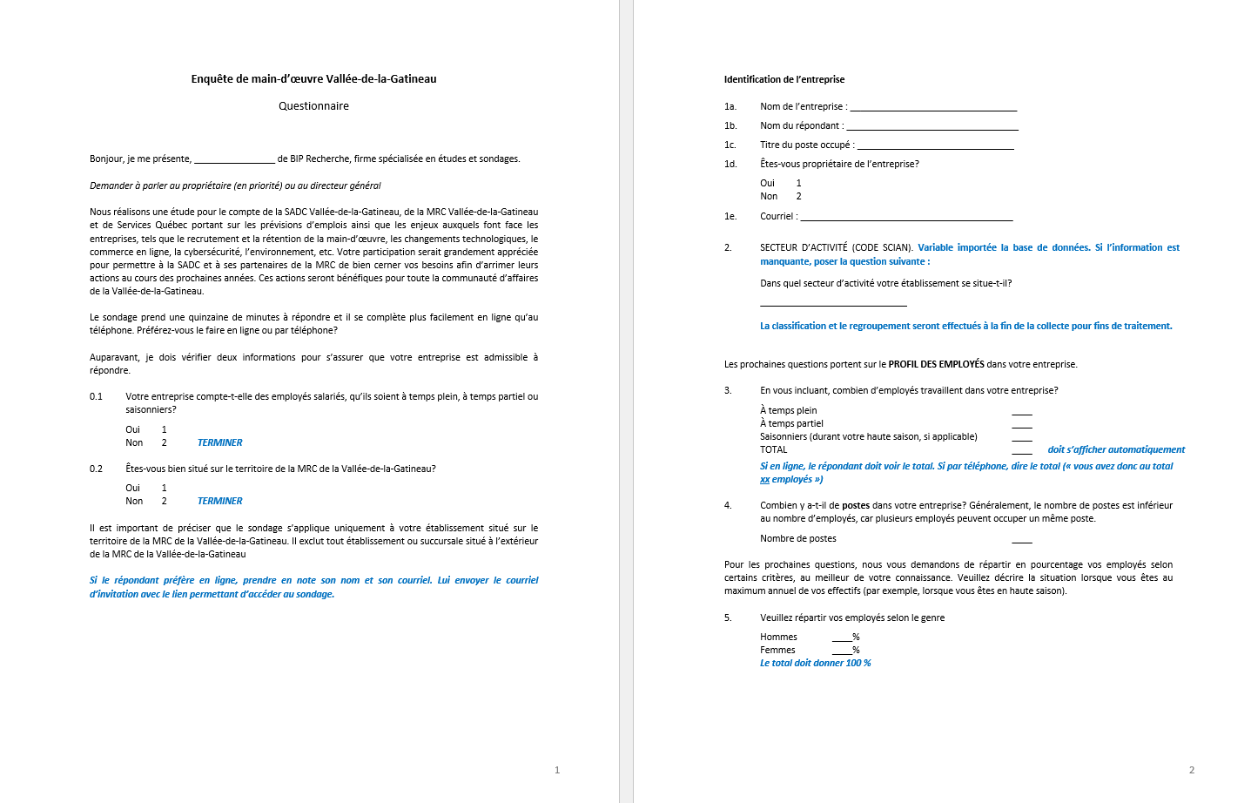
Questionnaire (1/6)

Slide 69
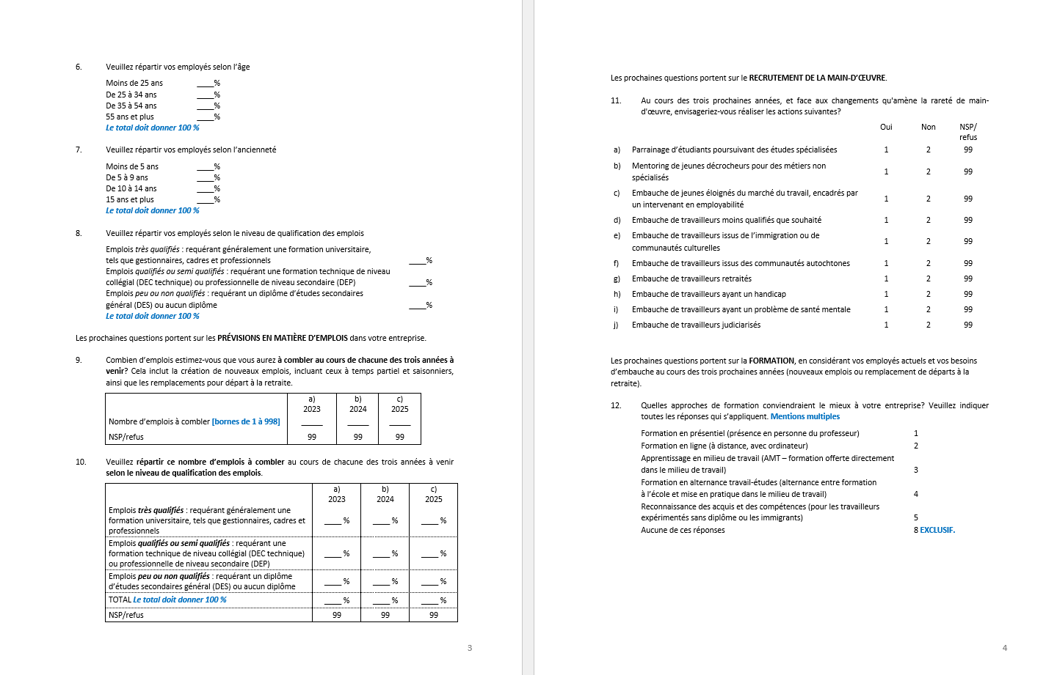
Questionnaire (2/6)

Slide 70
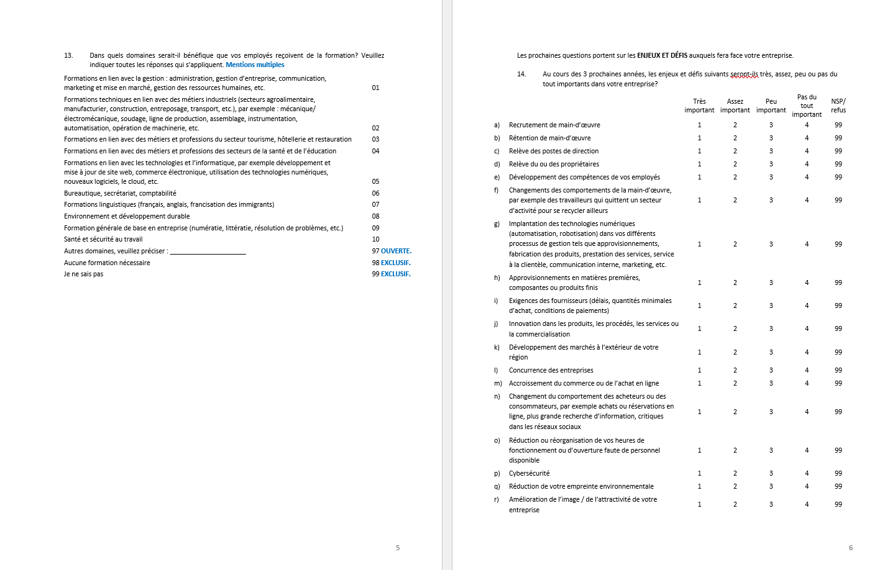
Questionnaire (3/6)

Slide 71
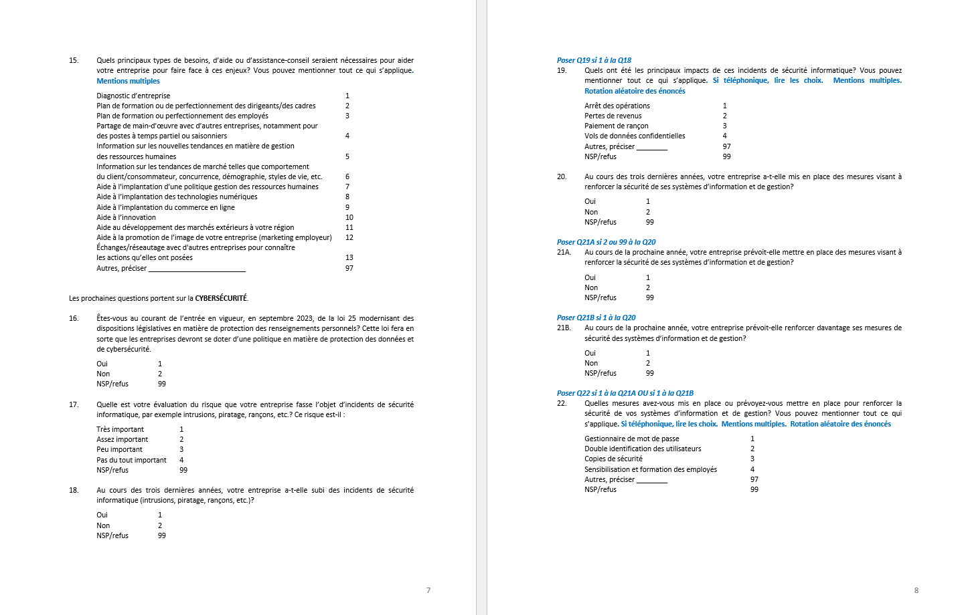
Questionnaire (4/6)

Slide 72
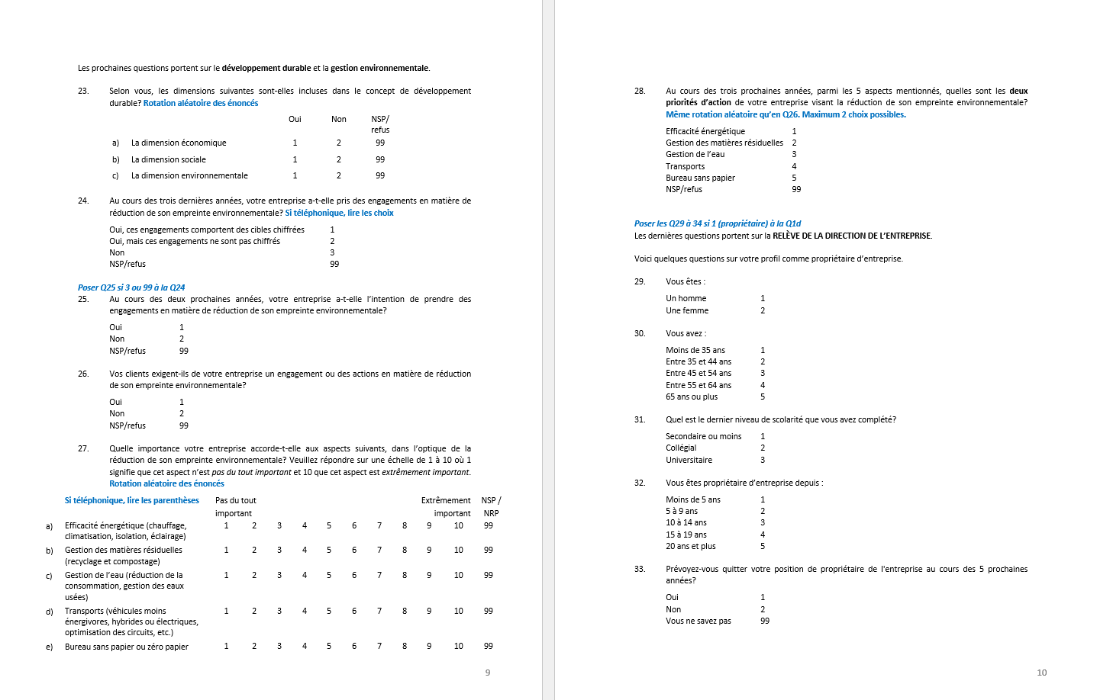
Questionnaire (5/6)

Slide 73
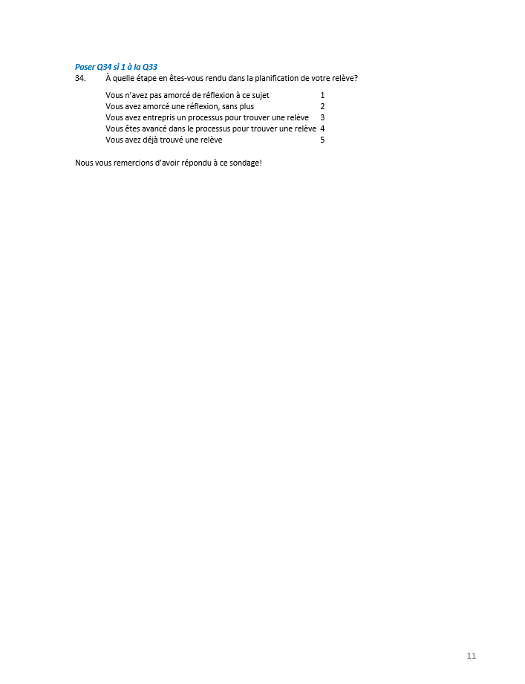
Questionnaire (6/6)

